Slide 1
Lazy Loading
A way to improve performance in an Angular application
Pranam Bhat

Slide 2
What is Lazy Loading?
Lazy loading is a technique in Angular that allows you to load JavaScript components asynchronously when a specific route is activated.
When the user navigates through the application, the bundles are loaded as required. It improves the Speed of the application. Basically, the Load Time
Loading the page will happen - only when the user navigates to the route of the respective module.
It can contribute to efficiency in the program's operation if properly and appropriately used.

Slide 3
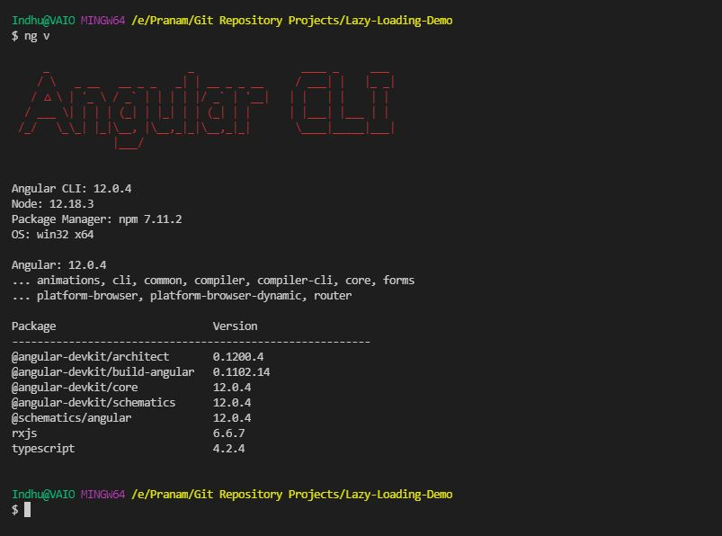

Slide 4
Example :
Step 1:
ng new LazyLoading-Demo
Step 2:
Create lazy loading module
To create a new module, we can use the following command:
ng g module lazy --flat
Note: The --flat flag keeps the file in src/app folder instead of its own folder.

Slide 5
Step 3:
Now we have to create two new components to demonstrate lazy loading.
ng g c lazy-parent skip-import
ng g c lazy-child skip-import
This will create the component – html and css files automatically in the lazy-parent and lazy-child directory.

Slide 6
Step 4:
Register our lazy-parent and lazy-child components in the lazy.module.ts file.
Step 5:
Remove lazy-child and lazy-parent registration from app.module file.
Step 6:
Point the app routing to the lazy loading module in app-routing.module.ts.

Slide 7
Step 7:
Now we can change our html files.
First we need to add the routerLink in app.component.html file.
We can change the lazy-parent html file to load the lazy-child component.

Slide 8
Time to run our application! - Go to terminal and run “ng serve” command.
Navigate to http://localhost:4200/
Meanwhile, let’s open “Developer Tools” (Ctrl + Shift + I)

Slide 9
When you click on the “Load Parent”, you will see “src-app-lazy-module.js” on the “Network” tab.
This is a chunk file generated after our Lazy Loading implementation.
These chunks are listed under “Lazy Chunk Files” when we do “ng serve” on the terminal.

Slide 10
The bundle files - “vendor.js", "polyfills.js", "styles.css", "styles.js“, “main.js” and "runtime.js" are loaded only during the first time when we start/load our application.
When we navigate to any other tab/page these files won't be loaded. Thus, increase the response time. This is the beauty of Lazy Loading.

Slide 11
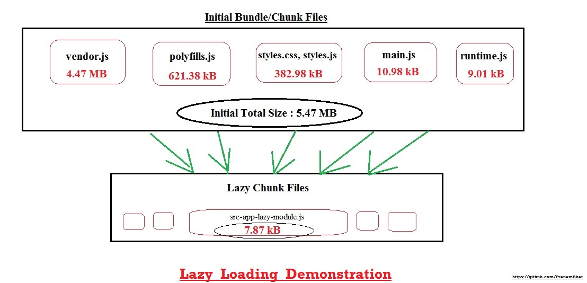

Slide 12
How to verify Lazy loading in Angular?
1. Run the following command to generate build:
npm run build
You can notice separate chunk is generated for the lazy loading module under “Lazy Chunk Files”.

Slide 13
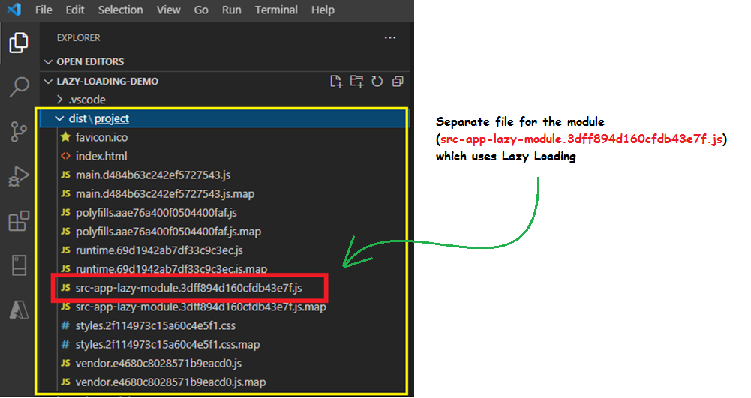
2. Another way to verify is to open the dist folder of your project:

Slide 14
Conclusion:
Advantages:
Minimizes start up time of the application.
Unnecessary request to server is avoided. Which improves the efficiency of the program.
Resource Consumption - Application consumes less memory because of on-demand loading.
Response Time – Amount of time it takes the web application to load and the User Interface to be responsive to the users.
Disadvantages:
Firstly, extra lines of code - to be added to the existing ones, to implement lazy load makes the code a bit complicated.
User experience may be affected. For example, backtracking may not be possible if the page structure is not optimal.

Slide 15

Tips:
If possible, do not lazy load routes that are most frequently visited by your users.
Keep your chunk sizes as small as possible (Only import what you need and keep shared modules as compact as possible).
Use router states to show a loader or animation when a lazy loaded route is being fetched so they do not think your application lags. You can even handle cases when fetching the lazy loaded route fails. Example: Show a toast notification and redirect to a previously loaded route.

Slide 16
Code Repository
https://github.com/PranamBhat/Lazy-Loading-Demo

Slide 17
Thank you!

